Slide 1

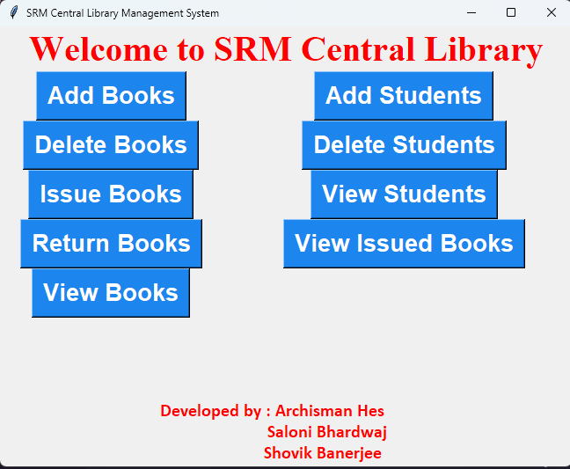
Library Management System
A library management system is a proficient and easy-to-use system for managing all processes involved in a library. With just a few clicks and edits, this system eliminates the need for manual work. Data can be securely stored and records can be easily searched.

Slide 2

Advantages of the Library Management System
1
Reduces Manual Paperwork
Automatically records information about books, eliminating the need for manual paperwork.
2
Efficient Book Management
Enables librarians to update book information, manage availability, and track book arrivals.
3
Saves Time and Effort
Eliminates the need for manual book search, saving time and effort.

Slide 3

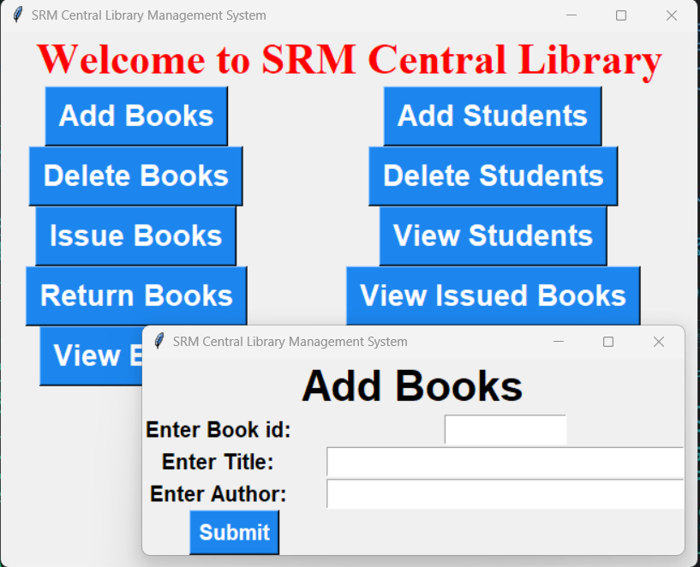
Book Renting Made Easy
With the library management system, users can easily rent a book by signing in with their details, and return it by the specified date. This system simplifies the book renting process, making it convenient for both book seekers and library staff.

Slide 4

Benefits for the Staff
1
Extra Authorizations and Privileges
The library management system provides staff members with additional authorizations and privileges, enhancing their efficiency and productivity.
2
Streamlined Operations
A single person can effectively manage the entire system, minimizing chances of errors and streamlining operations.

Slide 5

Library Management System: A Necessity
Nowadays, a library management system is essential for various organizations including schools, colleges, private libraries, and reference libraries. It helps in managing book issuing, return, and renewal processes efficiently. This software ensures accurate record-keeping and provides easy access to information.

Slide 6
The Proposed System
1
Add New Student
Easily add new student details to the system for seamless tracking and management.
Add New Book
2
Effortlessly update the system with information about new books, ensuring accurate record-keeping.
3
Issue Book to Student
Facilitate the process of book issuance to students, keeping track of borrowed books.
Return Book from Student
4
Efficiently track and manage book returns from students, ensuring prompt book availability.

Slide 7
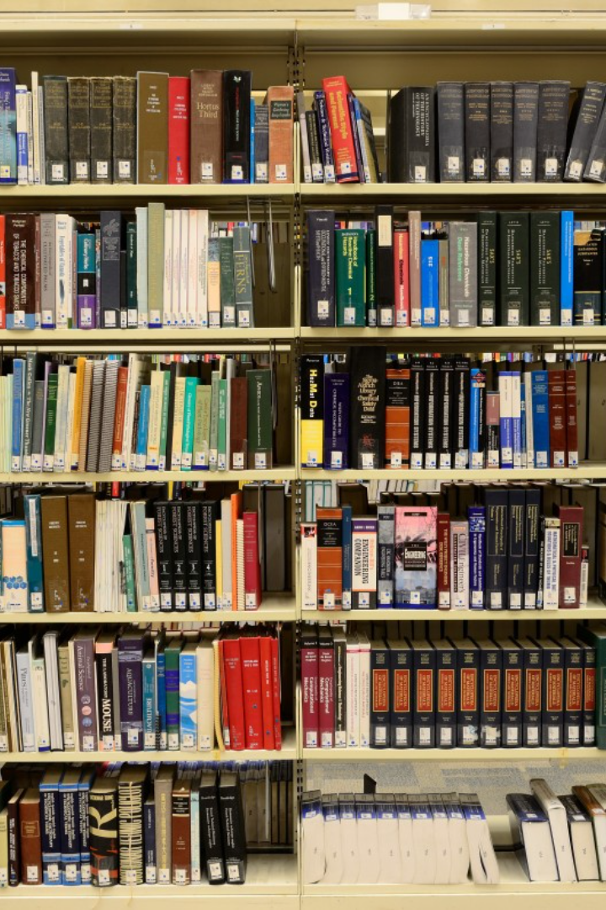
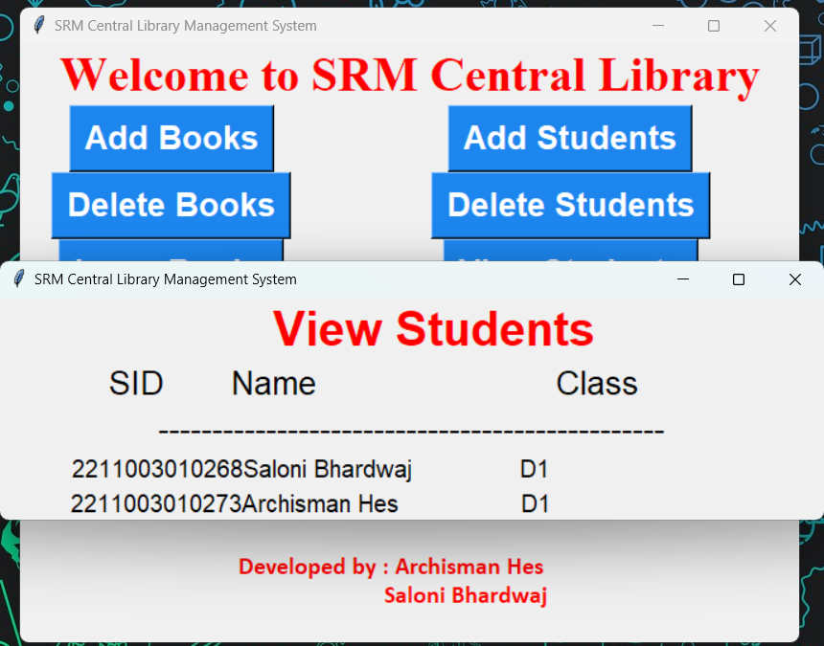
Better Information Access for Students
The library management system enables customers to easily search and find books. This software ensures quick and efficient access to the desired books, enhancing the overall customer experience.

Slide 8
Usage in Various Organizations
School Libraries
College Libraries
Effectively manage book issuing and returning processes in school libraries.
Streamline book management in college libraries, facilitating easy access to educational resources.
Private Libraries
Reference Libraries
Efficiently manage book inventory and enhance the library experience for private libraries.
Ensure accurate record-keeping and information access for reference libraries.

Slide 9

Automated Management for Public Libraries
The library management system is particularly beneficial for public libraries, modern public libraries, public leading libraries, and national libraries. It automates book issuing and return processes, making library management seamless and efficient.

Slide 10



The Magic of Automated Systems
Efficiency and Accuracy
Digitalization of Records
Data Analysis
Automated systems ensure efficiency and accuracy in managing library operations.
Leverage the power of data analysis to make informed decisions and optimize library services.
Avoid the hassle of manual paperwork and digitize all library records for easy access and management.

Slide 11

Conclusion
With the proposed library management system, all manual difficulties in managing a library will be rectified. Efficiency, accuracy, and easy access to information are guaranteed with this automated system. Say goodbye to the headache of manual paperwork and embrace a seamless library management experience.

